Slide 1






Slide 2
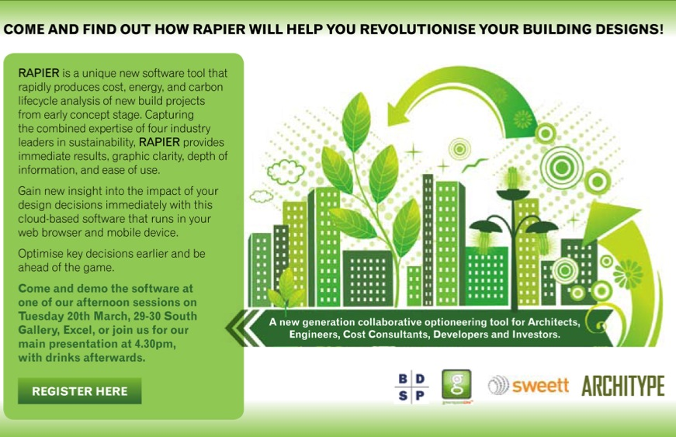
Presentation outline
Background
Project Consortium
Concept
The vision for RAPIER
Alpha prototype
Demonstration
On the horizon
Invitation to try software & provide feedback

Slide 3

Background
2 year R&D project (£937k) April 2010 – April 2012
46% funded by the Technology Strategy Board (TSB)
“Design & decision tools for ‘low impact’ buildings” focusing on new build early stage / concept design

Slide 4


Project consortium
BDSP Consulting Engineers
MEP & Environmental Engineers
Sweett Group
Cost & Project Management Consultancy
Architype
Architects & Sustainability Specialists
greenspaceLive
The Green Building Internet Company

Slide 5
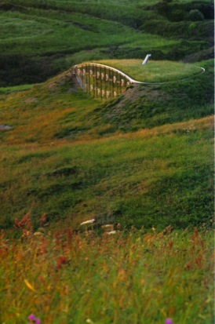

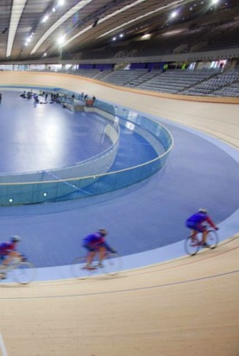
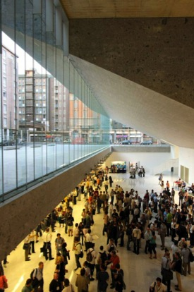
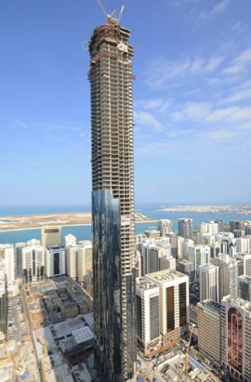
BDSP Partnership
International engineering and environmental consultancy
BDSP Engineering
BDSP Environmental
BDSP Simulation
BDSP Lighting
House in Wales
Pembrokeshire, UK
National Assembly
for Wales
London 2012
Olympic Velodrome
Bocconi University
Milan, Italy
Central Market
Abu Dhabi, UAE

Slide 6

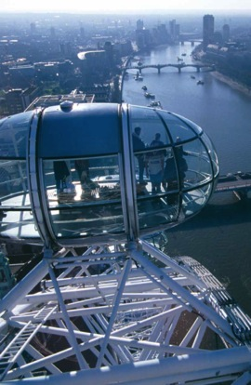
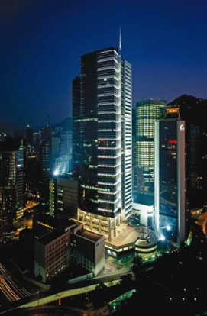
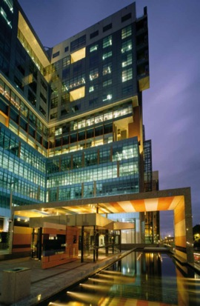
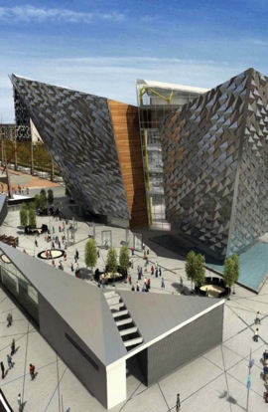
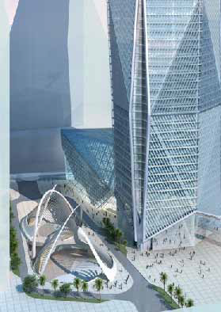
Sweett Group
Sweett Group provides clients with global expertise coupled with local sector knowledge including:
Cost Management
Programme and Project Management
Strategic Advisory
Property Development Services
London Eye
£15m – Capsule refurb
Hong Kong Police HQ
HK$2.2m
Melbourne Law Courts
Aus$108m
Titanic Quarter
£90m
CMA Tower
Riyadh

Slide 7
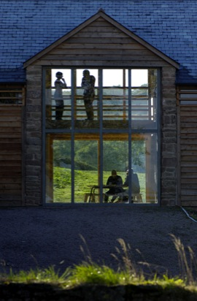
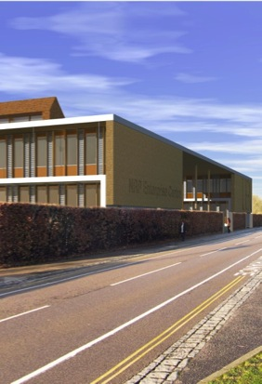
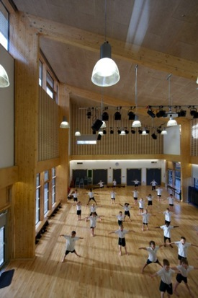


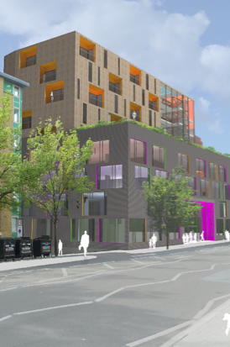
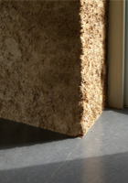
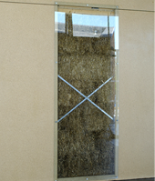
Architype
Architype Ltd is an awarding winning and regularly published Architectural practice, with:
Projects ranging from £100K to £17million
Offices in Hereford & London
Recognised expertise in sustainable design
Strong collaborative & consultation ethos
At forefront of low energy buildings research
West Office - Barn
Ecological refurb
UEA – NRP Centre
Negative carbon building
Bushbury Primary
Passivhaus school
Genesis SCA&T
Sustainable construction
York House
Low energy complex

Slide 8

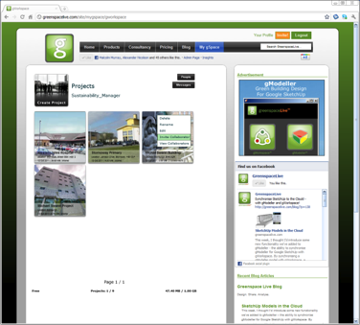
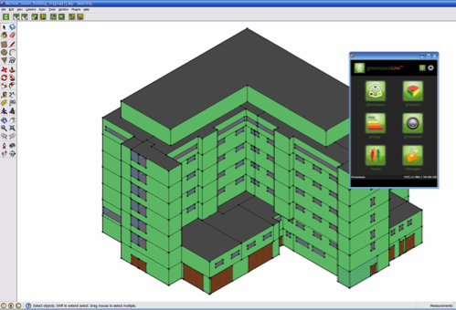
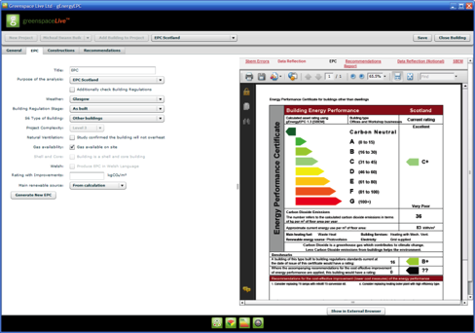
greenspaceLive
Energy and low carbon software spin-out from the University of the Highlands and Islands:
5 year R&D programme
3 year partnership with Green Building Studio until acquired by Autodesk
First energy analysis plugin for Google SketchUp
Global business partnerships and users
gWorkspace
collaboration and sharing
messaging and alerts
gModeller
Automatic attribution of SketchUp faces to
generate gbXML spaces, surfaces etc…
gEnergy
Integration with energy analysis engines
SAP, EPC & Energy reports

Slide 9
Concept
RAPIER - the easiest to use and most powerful web based energy / cost / carbon decision making tool for the Built Environment
Notes:
A cost effective testing of options is needed prior to detailed design stage
- New generation tool with excellent usability
- Tuned for early design stages
- Support for design and decision-making processes
- Costing is integral to the tool, not a “bolt on”
- Optimisation engine
- Innovative pricing models
- Model building can be fully (but intelligently)
attributed in “one click”…. but users also have flexibility.
9

Slide 10
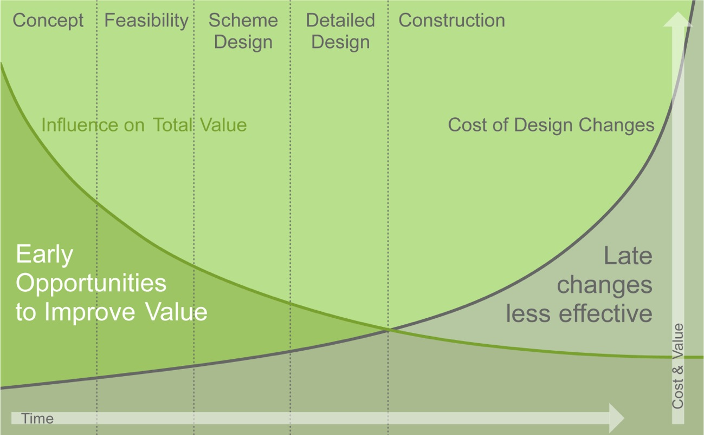
Early design decisions have big impacts…
Notes:
Major decisions have to be taken early in the design process…these decisions are currently being taken on the basis of incomplete or poor quality information resulting in:
Long-term costs borne by clients / developers
Increased environmental impacts
Low productivity & abortive work
Low design & building quality
Incomplete Information
Over-design
RiskBarriers
- Need to be an expert
- Requires multiple programmes – non-colloborative - results are hard to combine
- Extensive training required
- Generally single output – no inbuilt support optioneering or optimization
Time – inputting large quantities of data
Significant calculation time particularly for energy solvers
> Difficult to visualize the affect of changes on results
Underlying data often hidden
Ease of use often compromises transparency, flexibility and power
ALL OF THAT ADDS UP TO:
Signficant time, training, expertise and cost
A barrier to carrying analysis when project poorly defined is very high
MAJOR DECISIONS TAKEN EARLY-ON ON BASIS OF INCOMPLETE INFORMATION
LONG-TERM COSTS BORNE BY DEVELOPER/CLIENT
LOW PRODUCTIVITY IN CONSTRUCTION SECTOR
LOW DESIGN/BUILD QUALITY
HIGH COSTS (CAPITAL &/OR OPERATIONAL/LIFECYCLE)
INCOMPLETE INFORMATION
SLOW RESPONSE TO DESIGN PROCESS – HIGH TIME AND COST OF BUILDING MODELS
LACK OF INTER-OPERABILITY (HIGH-LEVEL DATA EXCHANGE)
LACK OF COLLABORATION (PROFESSIONAL RESPONSIBILITIES)
10

Slide 11
?
Gaps in knowledge…
Early Design Stages
Specialist consultants not appointed
Limited fee & time available
Very difficult to quickly establish:
  Lifecycle costings (Net Present Value)
  Operational energy & costs
  Embodied carbon
  Impact of location, siting & form
  Total cost & carbon benefits to client of pursuing alternative design strategies
Notes:
Barriers
- Need to be an expert
- Requires multiple programmes – non-colloborative - results are hard to combine
- Extensive training required
- Generally single output – no inbuilt support optioneering or optimization
Time – inputting large quantities of data
Significant calculation time particularly for energy solvers
> Difficult to visualize the affect of changes on results
Underlying data often hidden
Ease of use often compromises transparency, flexibility and power
ALL OF THAT ADDS UP TO:
Signficant time, training, expertise and cost
A barrier to carrying analysis when project poorly defined is very high
MAJOR DECISIONS TAKEN EARLY-ON ON BASIS OF INCOMPLETE INFORMATION
LONG-TERM COSTS BORNE BY DEVELOPER/CLIENT
LOW PRODUCTIVITY IN CONSTRUCTION SECTOR
LOW DESIGN/BUILD QUALITY
HIGH COSTS (CAPITAL &/OR OPERATIONAL/LIFECYCLE)
INCOMPLETE INFORMATION
SLOW RESPONSE TO DESIGN PROCESS – HIGH TIME AND COST OF BUILDING MODELS
LACK OF INTER-OPERABILITY (HIGH-LEVEL DATA EXCHANGE)
LACK OF COLLABORATION (PROFESSIONAL RESPONSIBILITIES)
11

Slide 12
Existing analysis workflows have limitations…
Client
Developer
PM
Architect
Environmental
Consultant
Cost
Consultant
All
Consultants
Software
£2k
Unique
File Format
Software
£2k
Unique
File Format
Software
£2k
Unique
File Format
Building Model
Building Model
Building Model
Time Spent
to Attribute
Model
Slow and
Complex
to Alter
Time Spent
to Attribute
Model
Slow and
Complex
to Alter
Time Spent
to Attribute
Model
Slow and
Complex
to Alter
Analysis &
Results
Analysis &
Results
Analysis &
Results
Reporting
Reporting
Reporting
Integration of
Analysis
Optimal Building Design?
Notes:
The limitations of existing lifecycle analysis tools and workflows create significant barriers to understanding the true impacts of early stage design decisions.
The results are:
Duplication
Limited scope for collaboration
Limited scope for optioneering / optimisation
Results hard to combine & visualise
Expense!
Barriers
- Need to be an expert
- Requires multiple programmes – non-colloborative - results are hard to combine
- Extensive training required
- Generally single output – no inbuilt support optioneering or optimization
Time – inputting large quantities of data
Significant calculation time particularly for energy solvers
> Difficult to visualize the affect of changes on results
Underlying data often hidden
Ease of use often compromises transparency, flexibility and power
ALL OF THAT ADDS UP TO:
Signficant time, training, expertise and cost
A barrier to carrying analysis when project poorly defined is very high
MAJOR DECISIONS TAKEN EARLY-ON ON BASIS OF INCOMPLETE INFORMATION
LONG-TERM COSTS BORNE BY DEVELOPER/CLIENT
LOW PRODUCTIVITY IN CONSTRUCTION SECTOR
LOW DESIGN/BUILD QUALITY
HIGH COSTS (CAPITAL &/OR OPERATIONAL/LIFECYCLE)
INCOMPLETE INFORMATION
SLOW RESPONSE TO DESIGN PROCESS – HIGH TIME AND COST OF BUILDING MODELS
LACK OF INTER-OPERABILITY (HIGH-LEVEL DATA EXCHANGE)
LACK OF COLLABORATION (PROFESSIONAL RESPONSIBILITIES)
12

Slide 13
A new generation of analysis tool
Cost
(Capital + Lifecycle)
Embodied Carbon / Energy
Operational Carbon / Energy
Notes:
Rapier is designed to support effective early stage decision making:
Rapidly attributed building models
…with a high level of customisation
Lifecycle Cost, Energy & Carbon analysis
Robust, compliant results
Fast
Flexible
Transparent
Easy to Use

Slide 14
Built for collaboration
Client / Developer
QS / Cost Consultant
Specialist
Consultants
Structural Engineer
Architect
Environmental
Engineer
(MEP)
Suppliers /
Manufacturers
Notes:
Barriers
- Need to be an expert
- Requires multiple programmes – non-colloborative - results are hard to combine
- Extensive training required
- Generally single output – no inbuilt support optioneering or optimization
Time – inputting large quantities of data
Significant calculation time particularly for energy solvers
> Difficult to visualize the affect of changes on results
Underlying data often hidden
Ease of use often compromises transparency, flexibility and power
ALL OF THAT ADDS UP TO:
Signficant time, training, expertise and cost
A barrier to carrying analysis when project poorly defined is very high
MAJOR DECISIONS TAKEN EARLY-ON ON BASIS OF INCOMPLETE INFORMATION
LONG-TERM COSTS BORNE BY DEVELOPER/CLIENT
LOW PRODUCTIVITY IN CONSTRUCTION SECTOR
LOW DESIGN/BUILD QUALITY
HIGH COSTS (CAPITAL &/OR OPERATIONAL/LIFECYCLE)
INCOMPLETE INFORMATION
SLOW RESPONSE TO DESIGN PROCESS – HIGH TIME AND COST OF BUILDING MODELS
LACK OF INTER-OPERABILITY (HIGH-LEVEL DATA EXCHANGE)
LACK OF COLLABORATION (PROFESSIONAL RESPONSIBILITIES)
14

Slide 15
Enabling optioneering & optimisation
Design
Energy Model
Carbon Analysis
Cost Analysis
Re-Design
Lifecycle Costing
Results
Time / Cost
Time
Notes:
Consultants not appointed yet

Slide 16
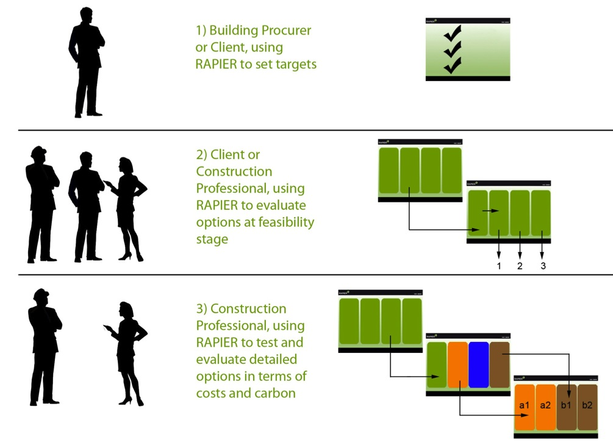
A wide range of users
Architect
MEP Engineer
Cost Consultant
Contractor
Client
Developer
Agents
Local Authority
Sustainability Consultant
Manufacturer
Academic

Slide 17
Vision
Notes:
A cost effective testing of options is needed prior to detailed design stage
- New generation tool with excellent usability
- Tuned for early design stages
- Support for design and decision-making processes
- Costing is integral to the tool, not a “bolt on”
- Optimisation engine
- Innovative pricing models
- Model building can be fully (but intelligently)
attributed in “one click”…. but users also have flexibility.

Slide 18
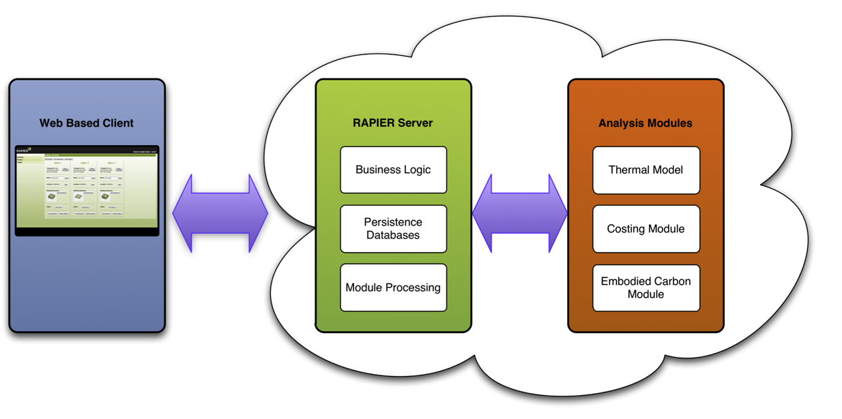
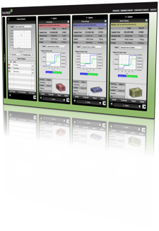
Cloud-based software architecture
Web based user interface
Device agnostic – Desktop, Mobile, Tablet
Powerful Cloud based processing
Notes:
Web based user interface
Device agnostic – Desktop, Mobile, Tablet
Cloud based processing
Powerful enterprise level server architecture
Centrally updated
Supports collaboration, optioneering & optimisation
Imports, generates & processes gbXML

Slide 19
Robust detailed models
Detailed research and data analysis to inform Cost, Energy, Carbon & Lifecycle engines by industry leading companies
Models based on industry standards to provide robust and compliant results
Capital & Lifecycle Cost Model
Based on Sweet Group cost analyses of recent project data
Energy & Services Model
Based on BDSP Suntool rapid thermal engine
Embodied Carbon Model
Based on Architype in-house embodied carbon calculator
£
kWh
CO2e

Slide 20
Cost Model
Capital Cost Model
Cost metrics:
- Floor Area
- Volume
- Façade area
- Basement volume
Context:
- Quality
- Site Constraints
- Usage
RAPIER MODEL
Notes:
Powerful cost modelling based on analyses of recent project data
Elemental cost analysis linked to building fabric and systems lifecycle cost projections

Slide 21
Cost Model
Lifecycle Cost Projection
Reference service life
Component quality
Design level
Work execution
In-use conditions
Maintenance levels
Estimated service life
Lifecycle Cost
Construction
Maintenance
Operation
End of life
Notes:
BCIS: life expectancy data
CIBSE: life expectancy data
ISO 15686 suite of standards
External environment factors
Internal environment factors
Anticipated build quality
Industry servicing cycles
Energy and Water model outputs
Operational / FM costs

Slide 22
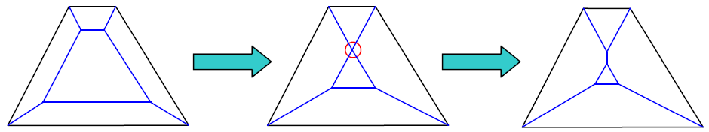
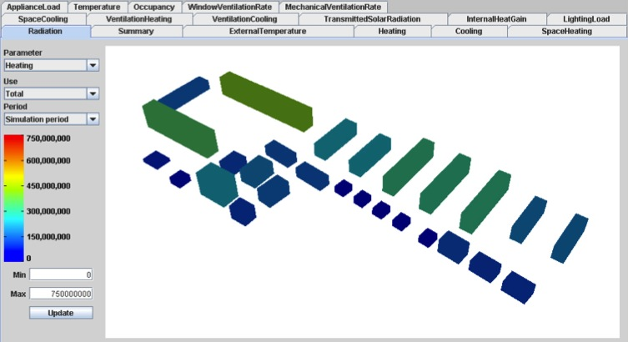
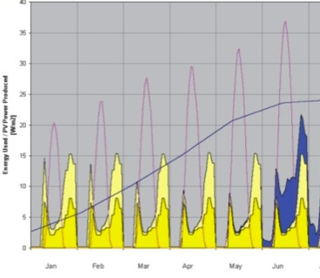
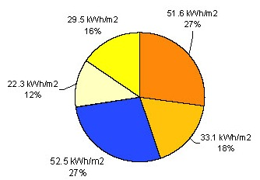
Energy Model
SUNTool
Development and extension of existing model (SUNtool)
Fast solving modeller returning detailed and accurate results in seconds
Automatic (implicit) zoning
Hourly or sub-hourly time steps
Plant & equipment sizing
Supports gbXML model geometry and constructions
Validated results

Slide 23

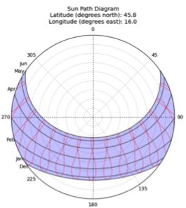
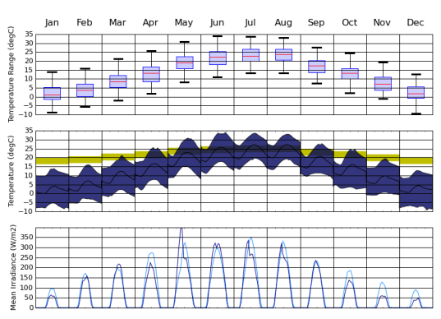
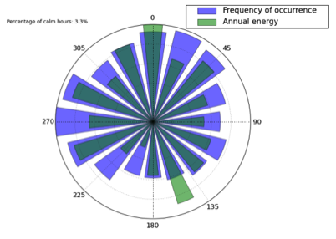
Services Model
Specialised Engines
Engines developed to provide early stage accurate guidance for:
Water services
Plant room sizing
HVAC services optimiser
Lift quantifier
Climate analysis tool
Supply
(Re) Use
Recycle

Slide 24
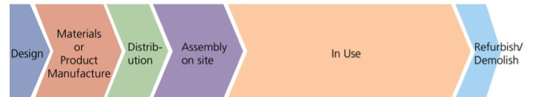
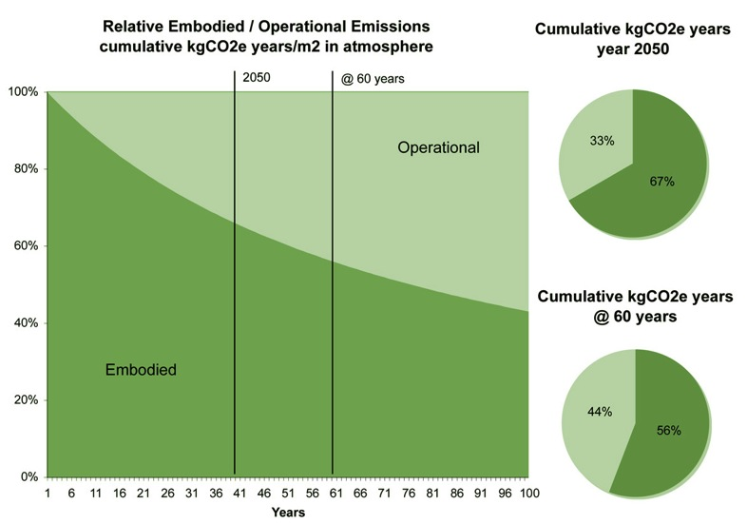
Embodied Carbon Model
Embodied Carbon
Model developed by Architype to support in-house research and analysis of live projects
Rich and traceable data sources of CO2e data from ICE v2.0, DECC & selected manufacturers
PAS 2050 compliance
Cradle-to-Gate and beyond: transport, construction, operation, end of life, re-use
Carbon storage (sequestration)
Carbon absorption (e.g. GGBS / Lime)
Dynamic global transport model
Customisable reporting & metrics (e.g. CO2 tonne years)
Transparent reporting

Slide 25
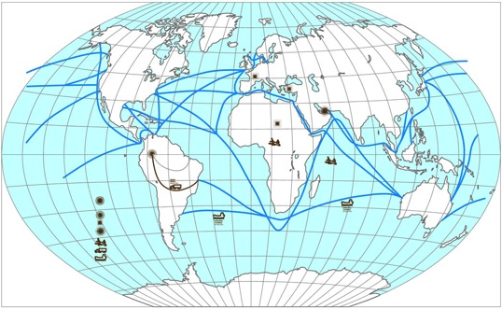
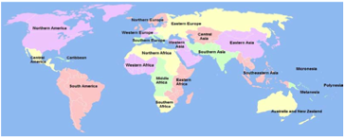
Transport Model
Transport
Geo-location of manufacture to calculate minimum transport distance
Air, sea and land based emissions split
Port to port and land based wiggle factors to account for real world transport routes
Initial Transport
Shipping
Final Transport
Landmass A
Sea / Air Priority
Landmass B
Point to Point Distance
Transport Distance
Point to Point Distance
Wiggle Factor
Wiggle Factor
Modal Split
Modal Split
Emissions
Emissions
Alternative Fixed Allowance
Gate
Land Transport Distance
Site
Sea Transport Distance
Transport Emissions
Air Transport Distance

Slide 26
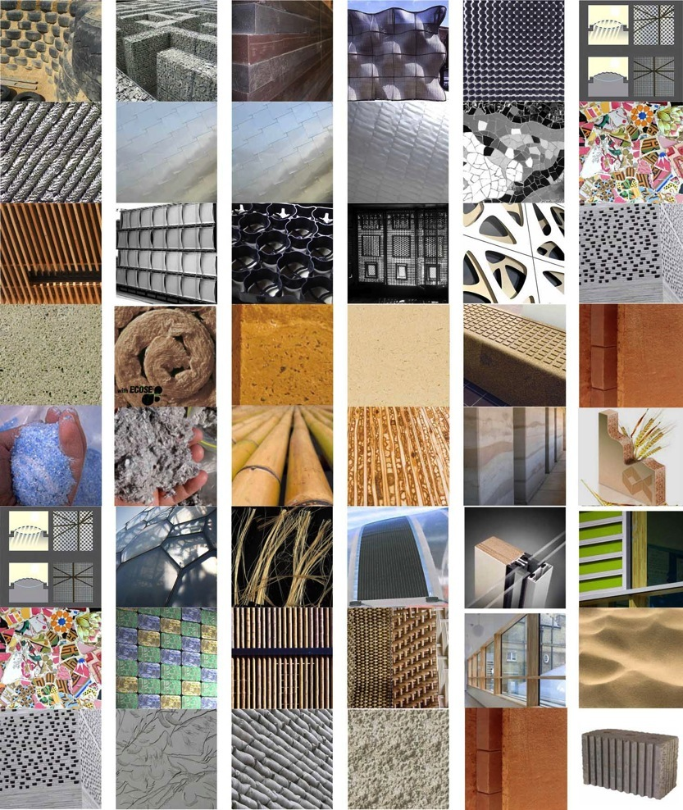
Libraries
Intelligent Defaults
Apply intelligent defaults to rapidly attribute a building geometry
Support for mixed use buildings
Customise defaults to let you make a fast start on your own projects e.g.
  Passivhaus School
  Supermarket
Rich libraries of materials, constructions & strategies

Slide 27
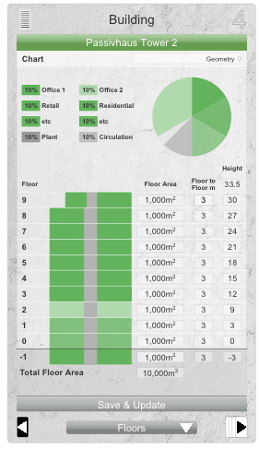
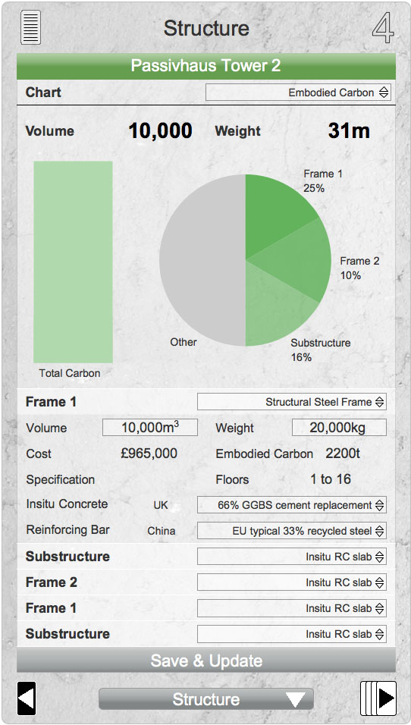
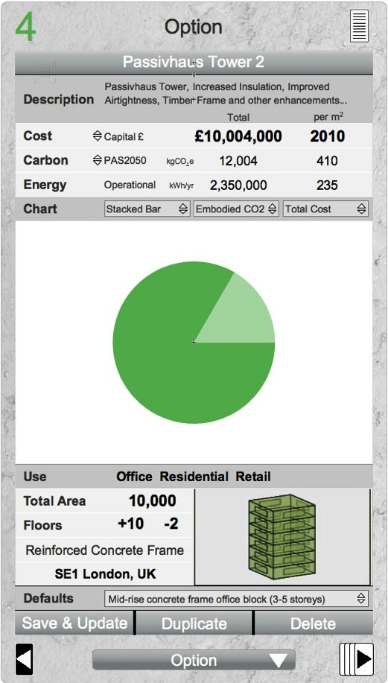
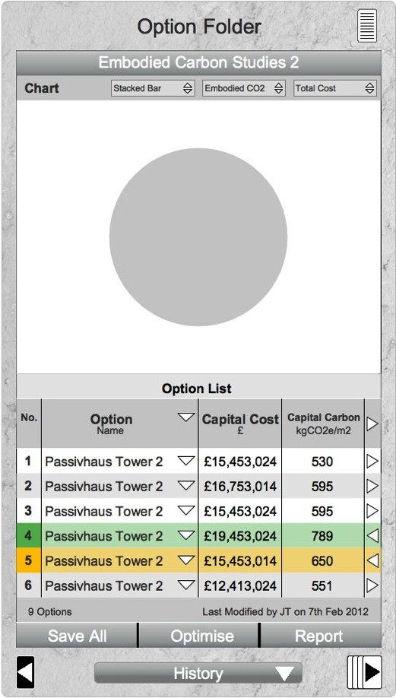
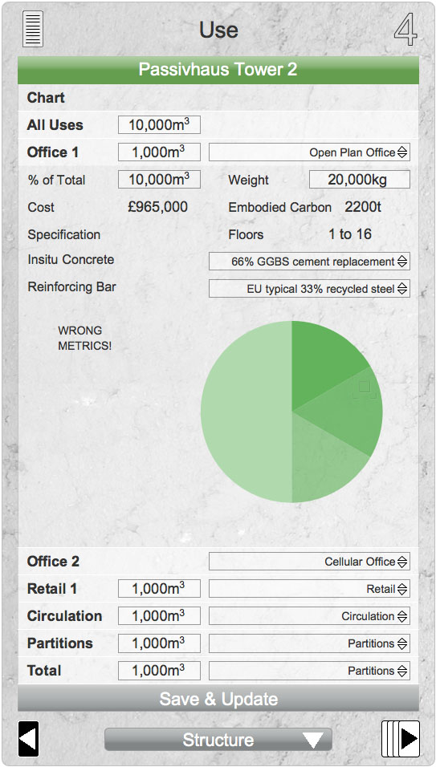
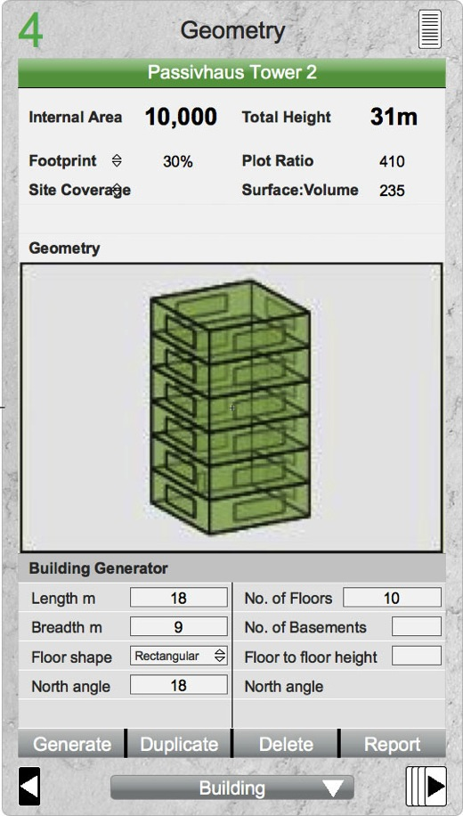
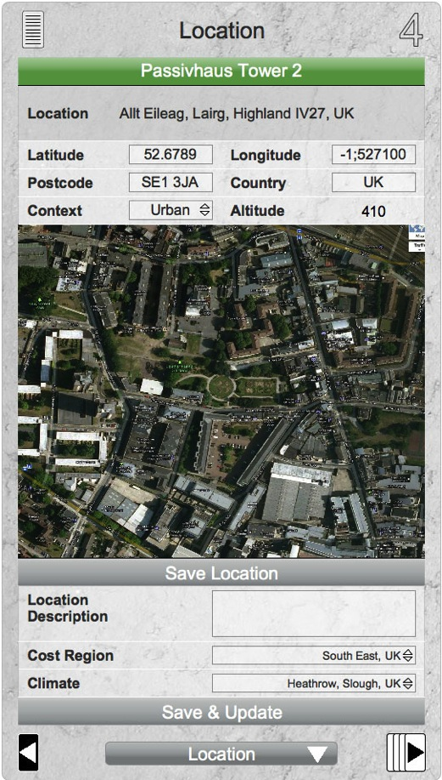
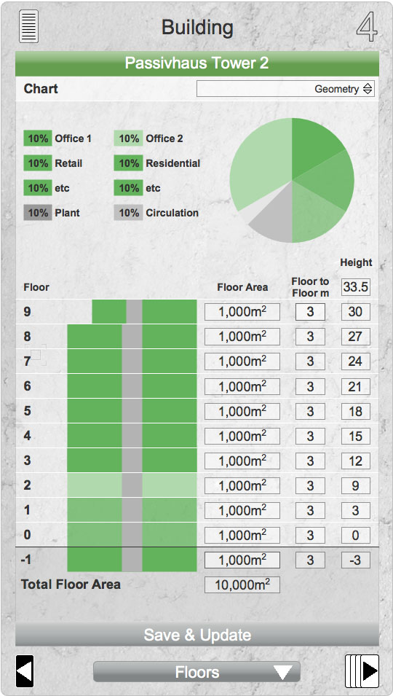
Intuitive user experience
Topic Cards
Focused high level reporting
Dynamically updating charts & metrics
Critical Inputs
A flexible intuitive workspace
Notes:
Quick selection from defaults and libraries
Dynamically updating key metrics, charts and graphics
Customisable workspace
See the impact of large or small design changes in context

Slide 28
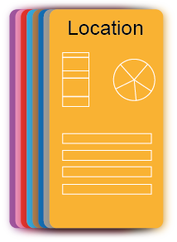



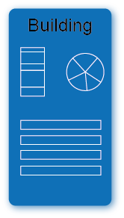
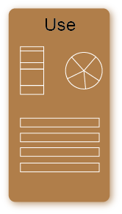
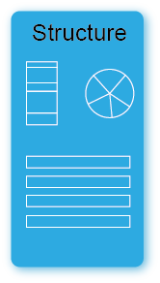
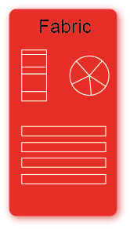

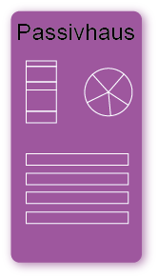





Workflow
+
Dynamically customisable workspace
New cards extend functionality and meet specific user needs

Slide 29

Optioneering
1
2
3
Rapid project definition & reporting

Slide 30
Optimisation
Auto-generate
Auto-filter

Slide 31
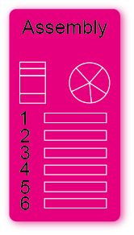

Dynamic reporting
Make adjustments and see results in context
Compare against targets

Slide 32
Dynamic reporting
Produce customised reports that can be dynamically linked to the underlying models
____________________________________________________________
____________________________________________________________
____________________________________________________________
p1
p2
p3

Slide 33


Transparent & customisable results
With RAPIER it is always possible to drill down into the model and review or change the underlying assumptions and data in the models:
Which carbon storage (sequestration) figures do you wish to use in your model?
TRADA / American Association of Timber / other
Do you believe that biomass as a fuel source is carbon neutral?
Do you want to model life expectancy of MEP equipment?

Slide 34



Interoperability
SketchUp
Import models from SketchUp
Enhancing BIM integration
Link with Green building workspaces
Export to SketchUp, Revit & various Energy modellers through gbXML e.g. Energy Plus
RAPIER
gbXML
SketchUp
Autodesk Revit
Energy Modellers

Slide 35
Alpha Prototype
Achievements to Date…
Robust web-based software platform in place
Cost, Energy & Carbon Models fully implemented
Support for mixed-use buildings – with Office use profiles defined
Card based user interface
Validation and testing ongoing
Work in Progress…

Slide 36

RAPIER Application – Option Cards

Slide 37

RAPIER Application – Building Editor

Slide 38

RAPIER Application – Detailed Building Editor

Slide 39

RAPIER Application – Location Editor

Slide 40

RAPIER Application – Energy Results

Slide 41

RAPIER Application – Financial Results

Slide 42

RAPIER Application – Embodied Carbon Results

Slide 43

RAPIER Application – Running Simulation

Slide 44

RAPIER Application – Assembly Library

Slide 45

RAPIER Application – Component Library

Slide 46

Impact
One meeting impact
Insight
Productivity
Communication and
collaboration
Optioneering
Optimising of cost, energy
& carbon

Slide 47



On the horizon
Further development, including;
Integration with SketchUp
Collaboration
Support for Compliance
Retrofit
Multi-building developments
Internationalisation
Future energy, regulatory and climate scenarios

Slide 48

Timeline
Alpha Testing & validation
Beta Testing
Full Release

Slide 49

Get involved…
http://www.projectrapier.com

